Slide 1
3D Content creation and visualization using glTF
Why the pipeline matters and how to work with Khronos

Slide 2
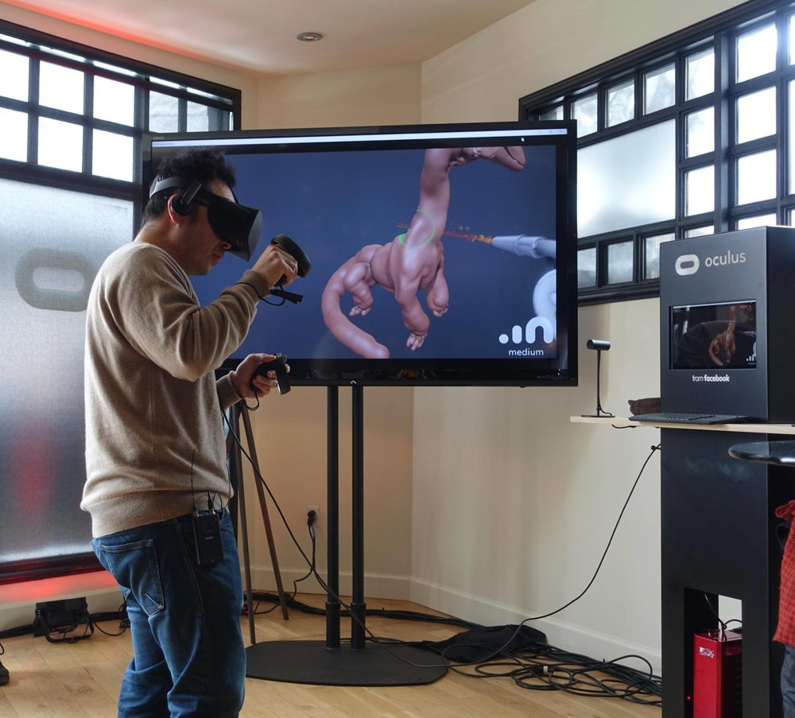

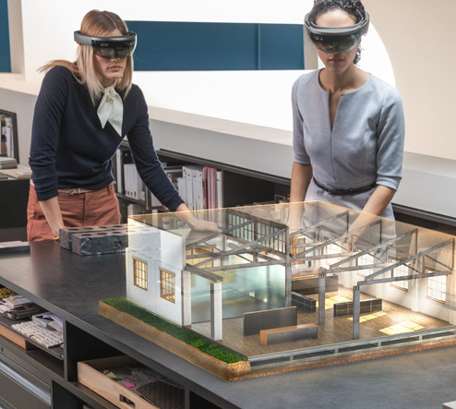
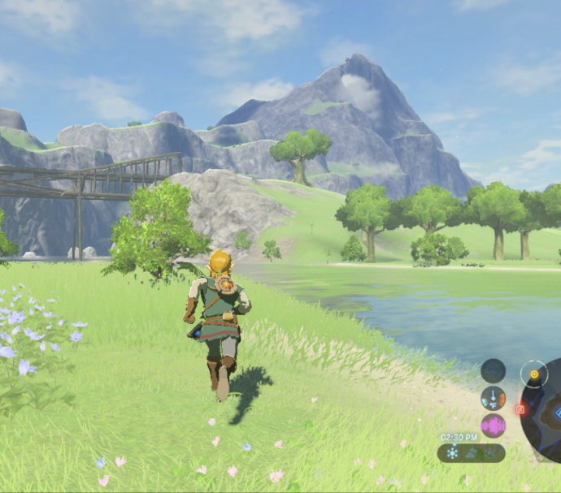
Content Pipeline – Why does it matter?
It’s all about content – content is King
Same process for all target technologies

Slide 3
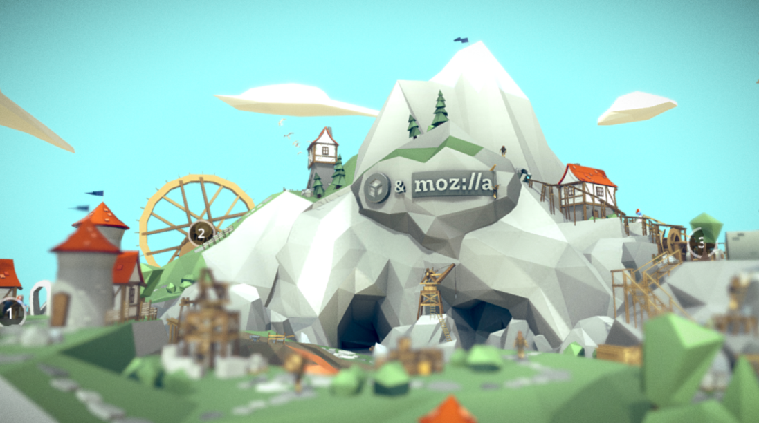


The Content Creation Process
To get this: (content)
You need this: (data + software)
To get data you need this: (resources)
Content creation is a resource heavy and complex process
The result is a large amount of data and software
Optimized workflow will save lots of time
Unleash the creativity of content producers

Slide 4
If done right amazing content can be created.
Streamlined pipeline process will allow massive content creation
Look at ’Fortnite’ and ’Clash Of Clans’
Suboptimal process may hinder and slow content creation
Look at Pokemon GO

Slide 5

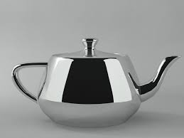
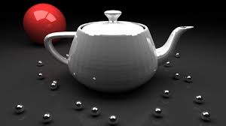
Visualization of content What you see is NOT what you get
Target
3D Engine
Content tool

Slide 6
Aim for photorealistic rendering with consistency across targets
Look and feel shall be the same
Target Platform & Technology
Marketing Area
Mobile
Content Creation Pipeline
Visualization
PC
Product Development Area
Content producer
Content producer
Data
Content producer
VR /MR
CAD
Manufacturing Area
AR
Render Engine
Video

Slide 7

How to get there - It’s all about light, reflection & refraction
We recognize materials based on how light interacts with them
Materials reflects or refracts light in different ways
Mostly solved by physically based rendering – microfacet BRDF
glTF supports PBR and has already reached a good level of maturity

Slide 8
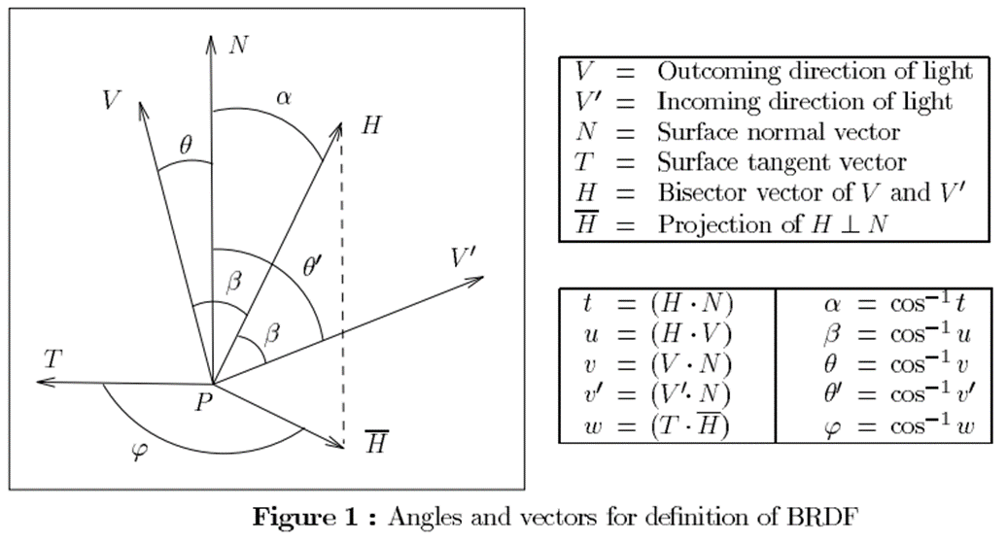
glTF – 4 components of the BRDF
Fresnel surface reflection (specular)
Microfacet distribution (normal distribution factor)
Geometric occlusion (masking and shadowing)
Diffuse term (Lambert)

Slide 9
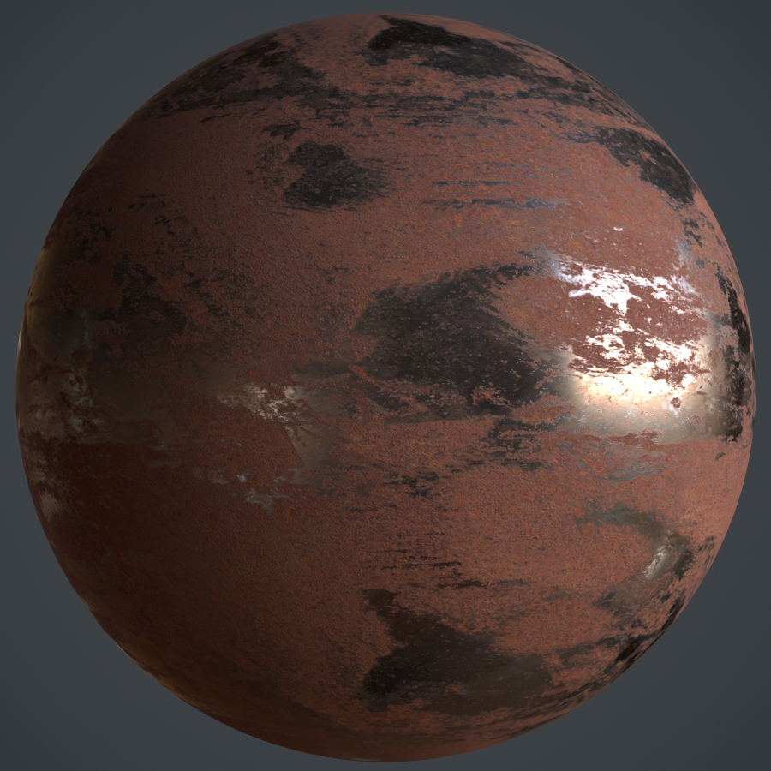
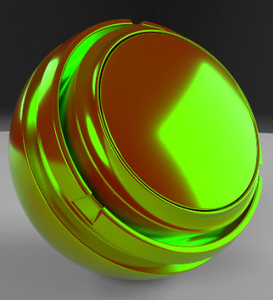
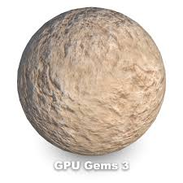
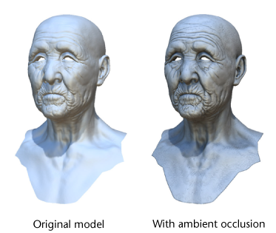
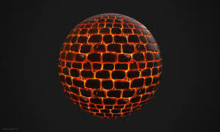
glTF –PBR material & light calculations Single layer microfacet BRDF
Metallic – Roughness
Specular – Glossiness (extension)
Normal map
Occlusion map – scale indirect light
Emissive map – light emitted

Slide 10
Next glTF features - focus on material properties
Textile material
Multiple layers - clearcoat material
Anisotropic reflections – eg brushed steel
Account for light leaving a surface (raytracing)
Scattered light (atmosphere, fog)
Collision – rigid & soft bodies
Unify illumination model – lighting should look the same across targets
Performance fallback – per model adaptation to target

Slide 11
Working with glTF & Khronos
Standardisation driven using gitHub
Pragmatic approach – looking for specification and implementation
Driven by efforts of the community If you want something done – do it yourself

Slide 12
How to contribute to Khronos - glTF
Substance
Plugin / Exporter
glTF –Render Engine
Target Platform
glTF
3DS Max
Blender
Vulkan
OpenXR
3D Commerce
Content tool exporter or plugin to support feature
glTF specification update or adding of extension
Reference implementation – renderer and/or shader code

Slide 13
In the beginning there was Collada
The Good
First effort from Khronos group to standardize 3d asset creation and delivery
Support from most major content creation tools
The Bad
Format defined as intermediate – ie between tools – not to target
XML based - poor binary support
The Ugly
No proper material definition
Data format may need some processing before display

Slide 14
glTF
Defined as a format to be used in target – as well as in pipeline
Specify common properties for material properties - PBR
Data structure very similar to how Vulkan / OpenGL works
Support for binary data (vertices/normals/tangents)
Extension to allow DRACO compression

Slide 15
How to scale resource for target platform
Metallic Roughness
Target Platform
glTF – Render Engine
Specular Glossiness
Mobile
Normal Map
PC
Occlusion Map
Emissive Map

Slide 16
Ending note -focus areas:
Framework for Content Creation and visualization using glTF (3D Commerce)
Work towards a proof of concept
Visual fidelity, consistency and mood as primary goal
Extend and add glTF material properties
Improved scene ambience
Unify illumination
Collision using rigid and soft bodies
Thank You!

